Slide 1
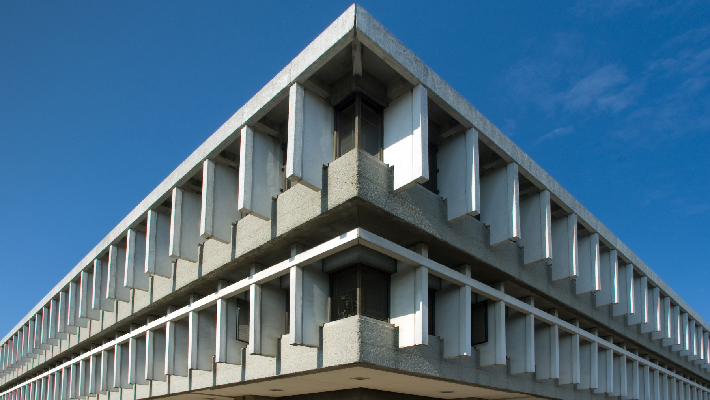

Who run the world? Visualizing the journey of female parliamentarians on global scale
CMPT 767: Visualization (Fall 2019) – Final Project
Anurag Bejju, Denise Chen

Slide 2
Video
Video Link
https://www.youtube.com/watch?v=L3XZHmBvLTw

Slide 3
CMPT 767: Visualization (Fall 2019) – Final Project Design Process
Anurag Bejju, Denise Chen

Slide 4
Purpose
Purpose 1: Visualize ranking of each country on yearly basis.
Purpose 2: Visualize the male vs female share (percent) for a particular countries parliament.
Purpose 3: Visualize the actual parliaments composition of that country divided based on gender.
(eg: if 400 seats -> 120 are female, 260 are male rep. seats.)

Slide 5
Step 1 : Understanding Data
Features | Examples
Rank | 1,2,3 …
Name | India, China
Year | 2019, 2018 ..
Total women cnt | 120
Total men cnt | 380
Total count | 400
Female percent | 30%
Abstract Type
Ordinal
Nominal
Interval
Ratio
Ratio
Ratio
Ratio
Physical Type
Integer
String
Integer
Float
Float
Float
Float

Slide 6
Step 2 : Visual Encoding (using Bertin Visual Variable)
Features | Examples
Rank | 1,2,3 …
Name | India, China
Year | 2019, 2018 ..
Total women cnt | 120
Total men cnt | 380
Total count | 400
Female percent | 30%
Characteristics
Ordinal
Nominal
Interval
Ratio
Ratio
Ratio
Ratio
Visual Variables I can use
P, S, V, T
P, S, V, T, C, O, S
P, S, V
P, S, V
P, S, V
P, S, V
P, S, V

Slide 7

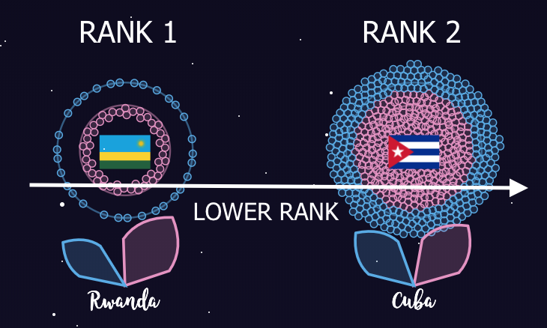
Step 3 : Representation (5 Features in one visualization)
Rank
Abstract Type | Ordinal
Visual Variable | Position
Characteristic | Order
Total women and men count
Abstract Type | Ratio
Visual Variable | Position, Color
Characteristic | Associative
Female Percent
Abstract Type | Ratio
Visual Variable | Size
Characteristic | Order
Country
Abstract Type | Nominal
Visual Variable | Position
Characteristic | Selective

Slide 8
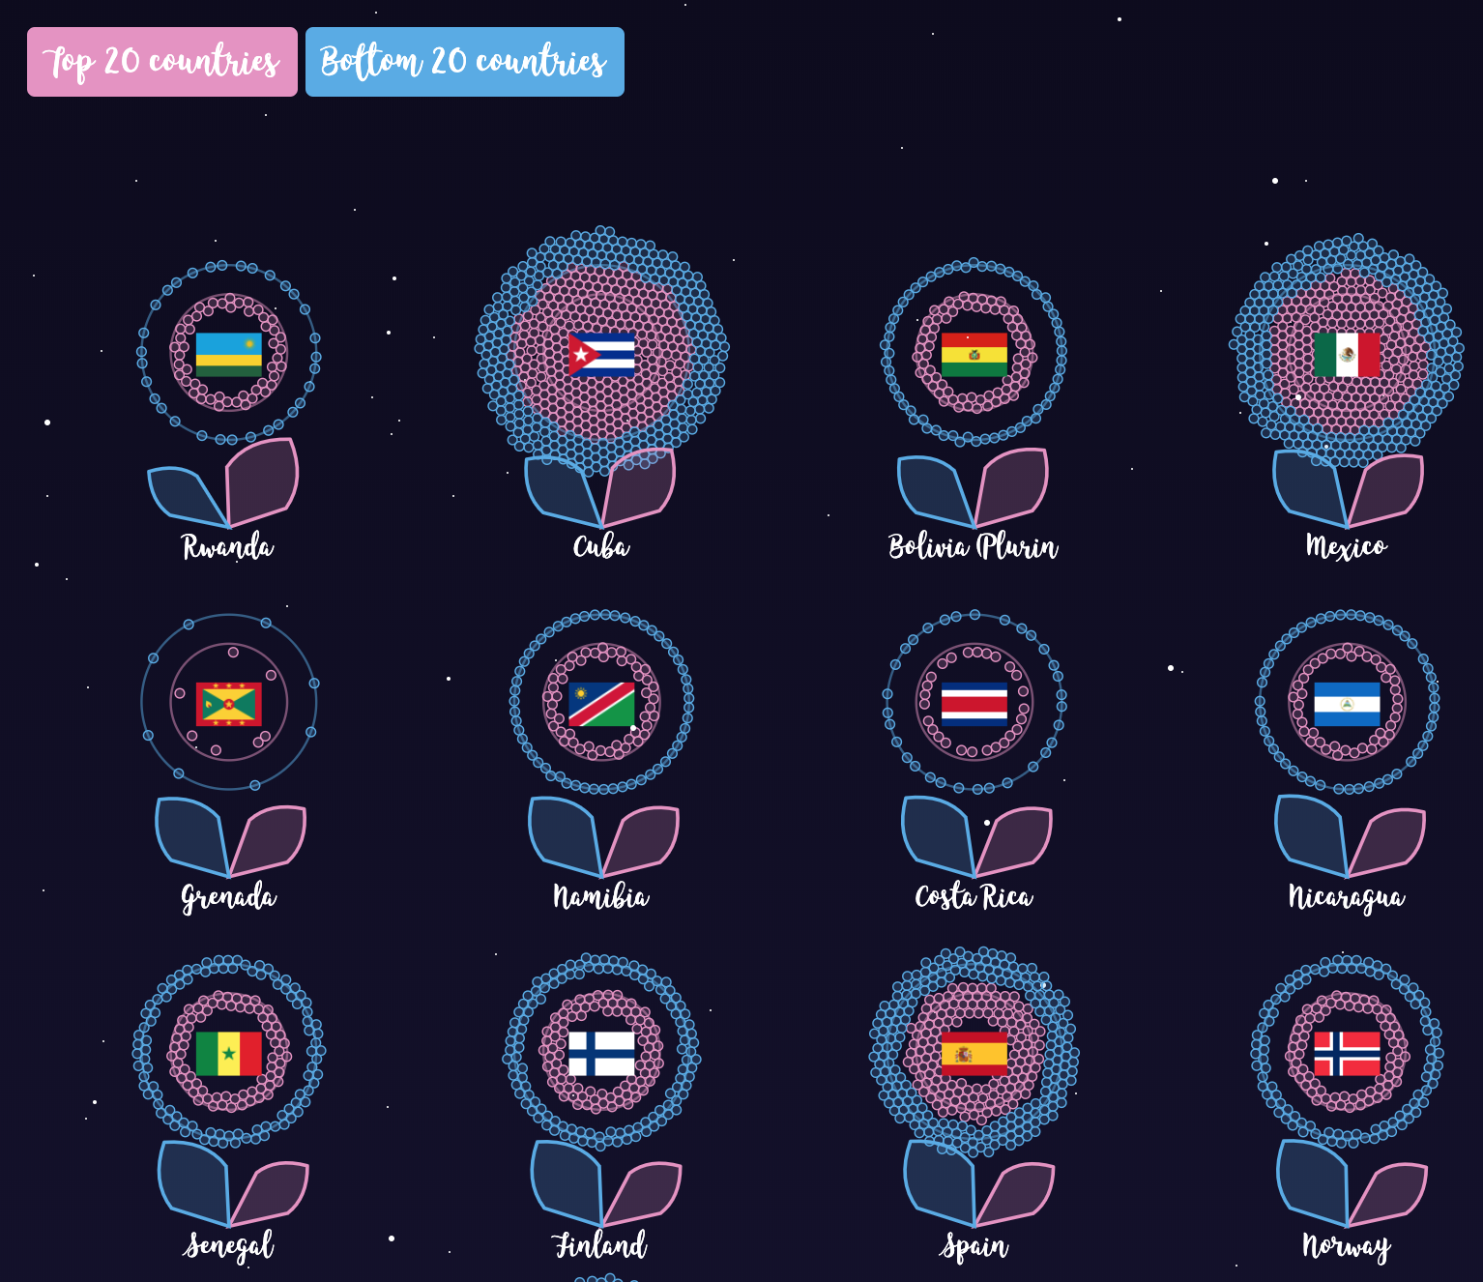
Step 3.1 : Color - Tufte Principles
Limit the use of bright colors.
Small bright areas, dull backgrounds
Use the colors found in nature.
Familiar, naturally harmonious
Use grayed colors for backgrounds
Quiet, versatile
Create color unity
Repeat, mingle, interweave

Slide 9
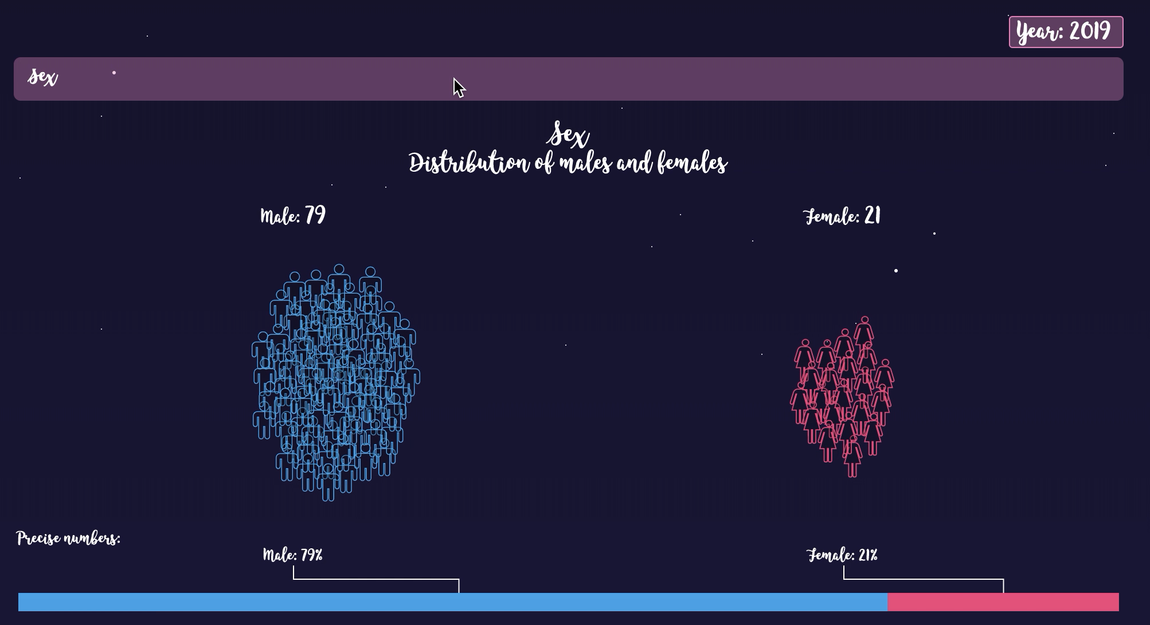
Step 4 : Presentation
Ideal Platform: Desktop, Laptop and big screen supportive. Not Mobile friendly.
Spatial Context
Multiple views (197) in a fixed limited space
Layout | Clustered Force Layout Bubble Chart
Temporal Context
Reduce Cognitive Effort Filter: specific tasks done in a short amount of time
Temporal Context
Higher degree of freedom

Slide 10
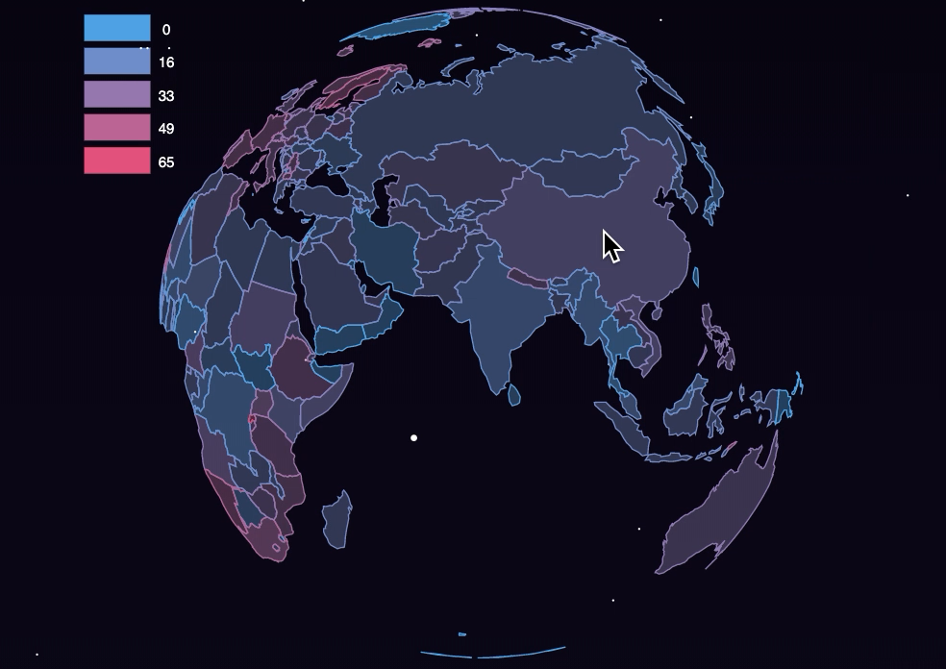
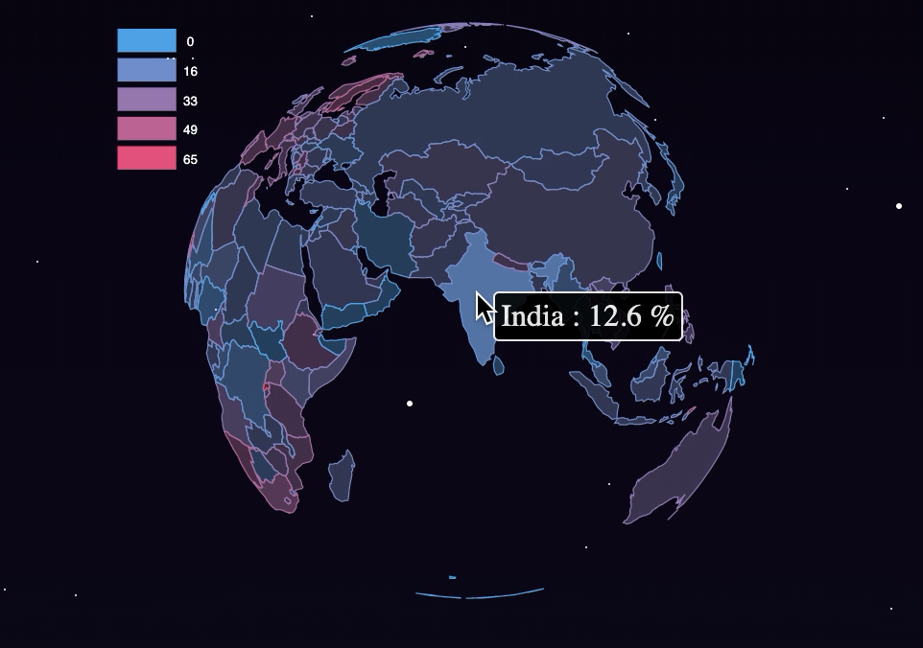
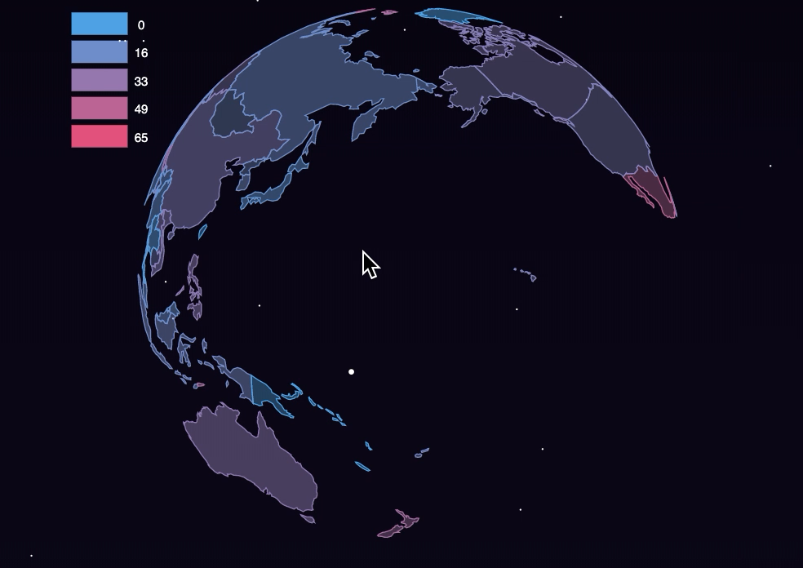
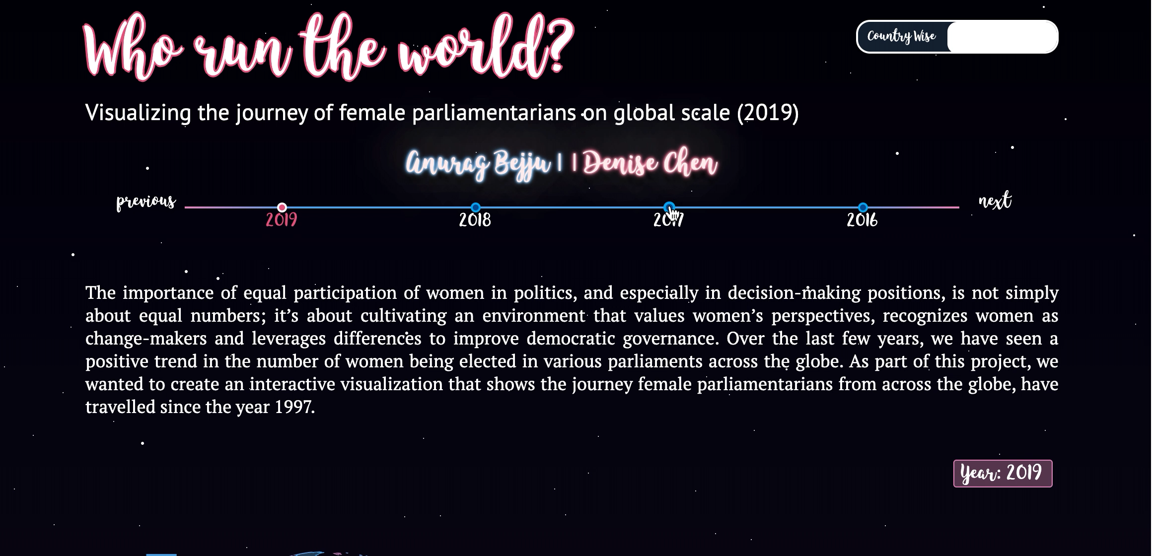
Step 5 : Interaction
Select
Highlight Area of Interest
Explore/ Elaborate
Zoom In/Out on Area of Interest
Reconfigure
Filter
Filter
Rotate Globe to a specific point
Change or Toggle View

Slide 11
Step 6 : Evaluation
Self Reflection: My partner and I evaluated each visualization based on 3 criteria's.
Serves the desired purpose
Does representation, presentation and interaction go together.
How well the actual data is reflected.
Experimenter Reflection (to some extent) :
Taken input from visualization specialists at Statistics Canada – Vancouver.
Collected a brief summary of their understanding of the visualization presented.

Slide 12
Future Work
Incorporate qualitative and quantitative parameters that would showcase the political, economic, social and educational affects associated with it.
Learn more story boarding and scroll responsive methods for future visualizations.
Try better evaluations methods and use constructive feedback to improve current visualization.

Slide 13
Thank you

